Slide 1
CAPSTONE Project
Forecast Model

Slide 2
Typical Planning Process
Large organizations, usu. MNCs, will prepare the annual or half-yearly Plan / Budgets, minimally, to set the financial direction of the year.
Annual budgets are typically prepared based on past performance, economic assumptions, competitors scene, etc, incorporated with a desired growth rate at the organizational level.
These are then broken down into budgets (or targets) for each department to achieve and contribute to the achievement of the overall organizational budget.
This is a typical top-down planning process.
The bottom-up planning process starts with departments’ budgets, and consolidated to derive the initial organizational level budget. Much discussion and debate before cascading the finalized budgets to the departments to achieve.

Slide 3
Business Question
Is the department able to meet or ideally exceed the budget ? How does the department ascertain that the given budget is achievable ?
What if there is a credible set of forecasts that can serve as a benchmark for the assessment of the budget and ongoing performance?
Identify the gaps to achieve the target
Develop a plan to close the gaps
Monitor the actual performance against the forecast to prompt timely actions to be made or identify new risk to the business

Slide 4
Objective of Capstone Project
Objective :
Create a credible set of full year forecast and next 28 days forecast of sales volume for a Retail Store of Walmart which has a full year sales target of 5% growth over prior year’s sales volume
Full Year (‘FY’) runs from current year 05-23 to next year-05-22
Desired Outcome :
Assess the given budget based on the FY forecast model to identify the gaps to achieve the target
Monitor the daily sales performance against the daily forecast to decide any actions required, identify changes to the current operating environment eg poor economic condition impacting the store sales

Slide 5
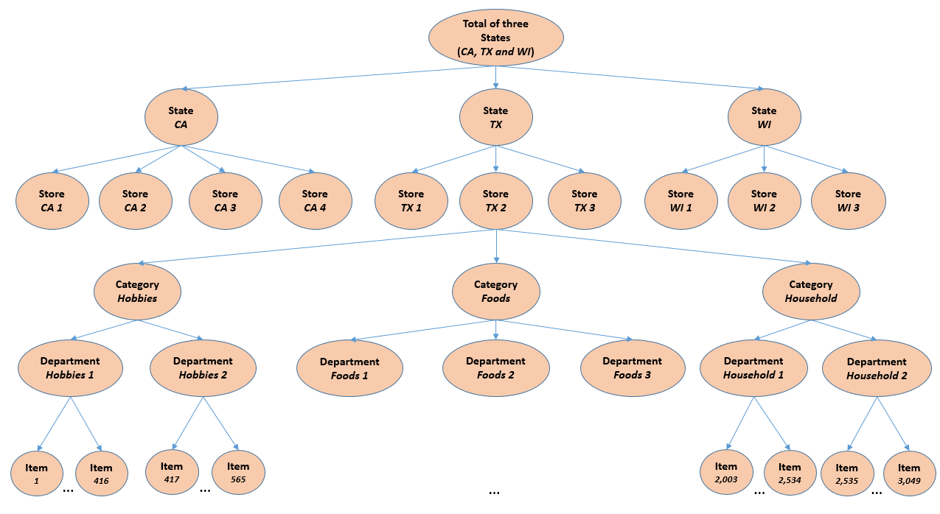
Walmart Retail Stores Structure
Hierarchy of 10 Stores across 3 states
California, CA
Texas, TX
Wisconsin, WI
3,075 Products in 3 categories, 7 sub-categories sold across 10 stores

Slide 6
Training & Testing Datasets
sales_train_validation.csv
Contains historical daily unit sales data per product and store, 1913 days / 5.2 years
1919 columns by 30490 rows
calendar.csv
Contains information about the dates on which the products are sold
14 columns by 1969 rows
Sell_prices.csv
Contains information about the price of the products sold per store and date
4 columns by 6,841,121 rows
Testing Dataset – sales_train_evaluation.csv
Similar to sales_train_validation with additional sales for d_1914 to d_1941
Using d_1914 to d_1941 for model testing
1947 columns by 30490 rows
Source of Datasets : https://www.kaggle.com/c/m5-forecasting-accuracy

Slide 7
Schematic of Datasets
Sales_train_validation
 | id | item_id | dept_id | cat_id | store_id | state_id | d_1 | d_2 | d_3 | d_4 | ... | d_1904 | d_1905 | d_1906 | d_1907 | d_1908 | d_1909 | d_1910 | d_1911 | d_1912 | d_1913
0 | HOBBIES_1_001_CA_1_validation | HOBBIES_1_001 | HOBBIES_1 | HOBBIES | CA_1 | CA | 0 | 0 | 0 | 0 | ... | 1 | 3 | 0 | 1 | 1 | 1 | 3 | 0 | 1 | 1
1 | HOBBIES_1_002_CA_1_validation | HOBBIES_1_002 | HOBBIES_1 | HOBBIES | CA_1 | CA | 0 | 0 | 0 | 0 | ... | 0 | 0 | 0 | 0 | 0 | 1 | 0 | 0 | 0 | 0
Sell Prices
 | store_id | item_id | wm_yr_wk | sell_price
0 | CA_1 | HOBBIES_1_001 | 11325 | 9.58
1 | CA_1 | HOBBIES_1_001 | 11326 | 9.58
Calendar
date | wm_yr_wk | weekday | wday | month | year | d | event_name_1 | event_type_1 | event_name_2 | event_type_2 | *snap_CA | *snap_TX | *snap_WI
5/2/2011 | 11102 | Saturday | 1 | 2 | 2011 | d_8 |  |  |  |  | 1 | 1 | 1
6/2/2011 | 11102 | Sunday | 2 | 2 | 2011 | d_9 | SuperBowl | Sporting |  |  | 1 | 1 | 1
7/2/2011 | 11102 | Monday | 3 | 2 | 2011 | d_10 |  |  |  |  | 1 | 1 | 0
* The United States federal government provides a nutrition assistance benefit called the Supplement Nutrition Assistance Program (SNAP). SNAP provides low income families and individuals with an Electronic Benefits Transfer debit card to purchase food products. In many states, the monetary benefits are dispersed to people across 10 days of the month and on each of these days 1/10 of the people will receive the benefit on their card.

Slide 8
EDA – Data Wrangling
calendar.csv
Replace with “nil” for columns with nan values
Convert categorical data to binary data columns
Convert to a timeseries dataset
sell_prices.csv
Convert a weekly data set to daily timeseries dataset
sales_train_validation.csv
Convert to a timeseries dataset
Merged above 3 datasets for modelling
Dataframes - Sales + Calendar + Sell Prices

Slide 9
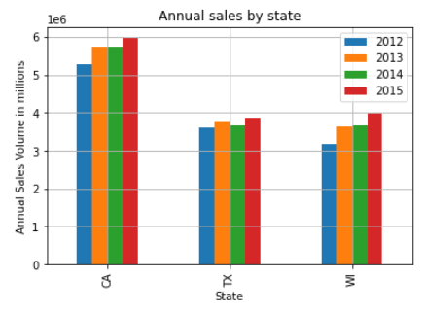
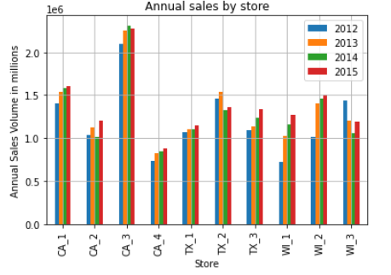
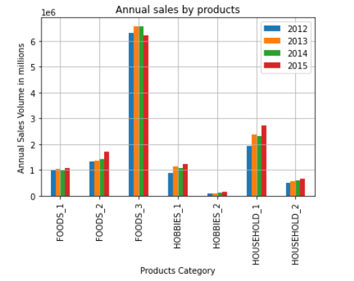
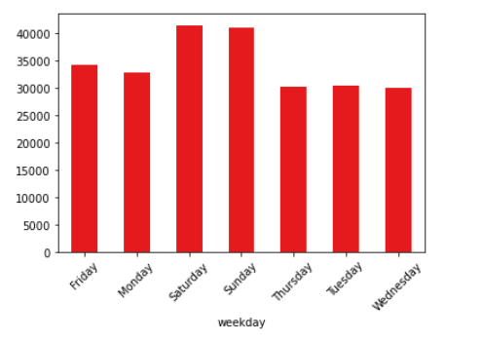
EDA – Features Analysis
1. Annual Sales by States
2. Annual Sales by Stores
CA is the best performing state
CA3 is the best performing store
3. Annual Sales by Products
4. Sales by weekdays
FOODS_3 is the best seller
Weekends are the top performers

Slide 10
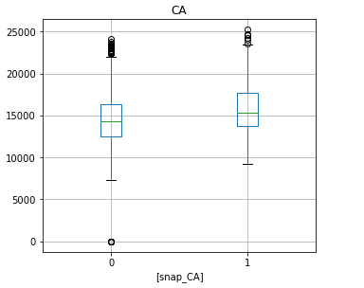
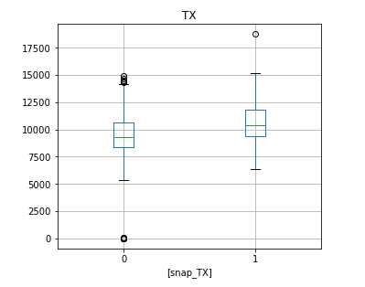
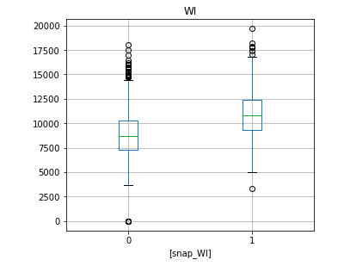
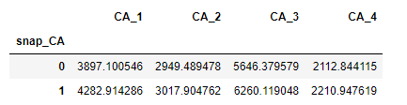
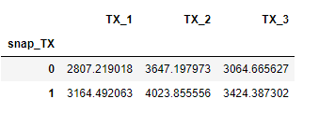
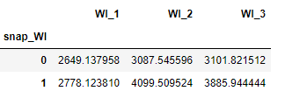
Drivers of sales volumes – SNAP events
Higher Mean Sales during SNAP events across the states and stores

Slide 11
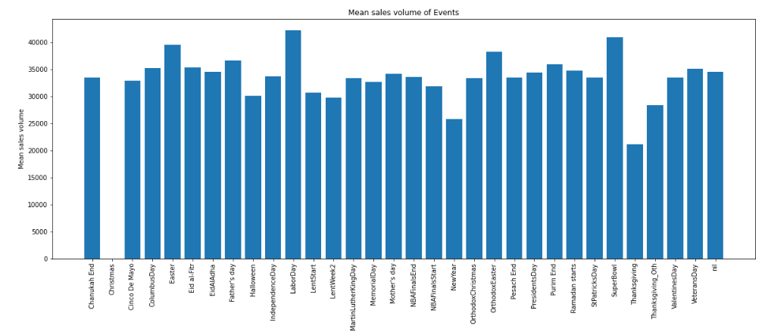
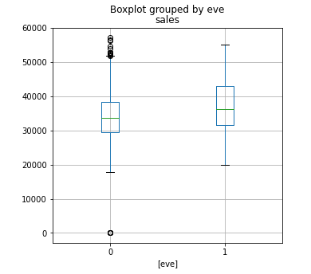
Drivers of sales volumes – Holidays & Other Events
Top sales volume on Labour Day, SuperBowl, Easter
Near zero sales on Christmas day
Lowest sales volumes on Thanksgiving and New Year
Higher sales volume on eve of holidays and events

Slide 12
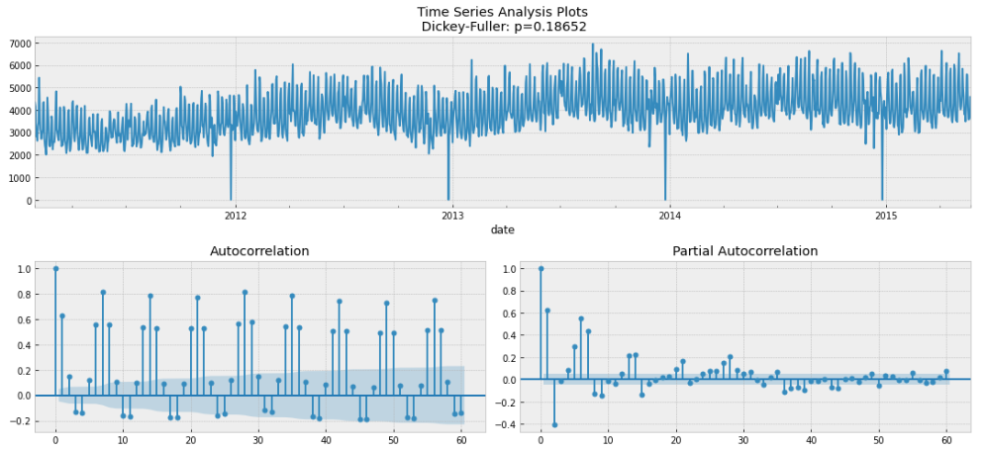
Full Year Forecast Model – Store CA1 Timeseries

Slide 13
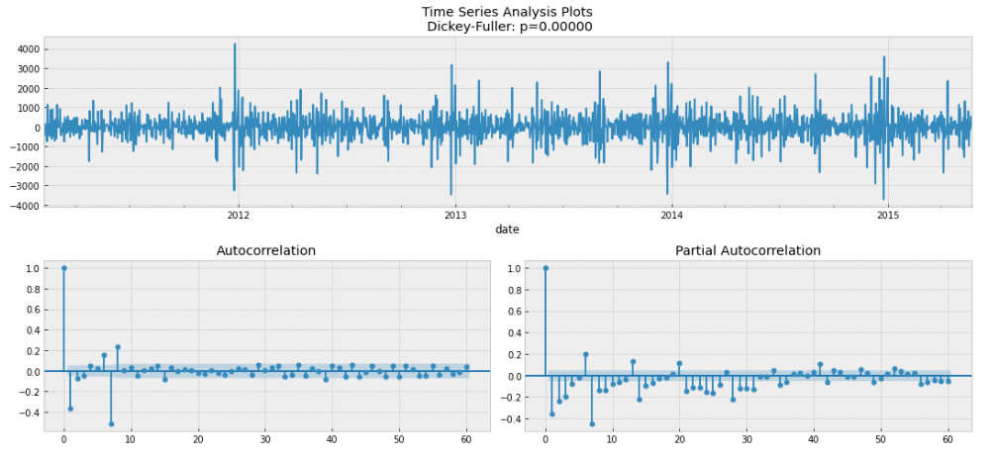
Prior to Modelling – Stationary & Seasonality
Differencing order of 1 to make the timeseries stationary
Seasonality = 7 days

Slide 14
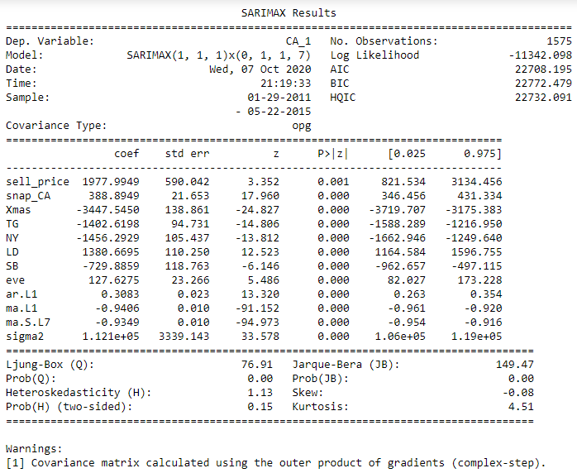
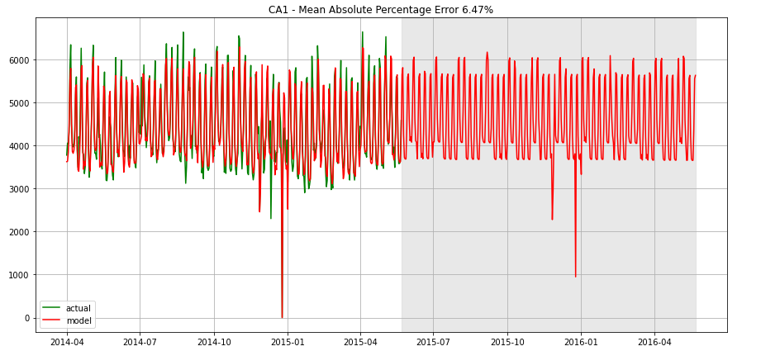
Store CA1 Full Year Model
Econometric approach SARIMA
Drivers of sales volumes ie Exogenous variables – SNAP event, Sell Prices, 5 events ie X’mas, Thanksgiving, New Year, Labour Day and Super Bowl, & eve of holidays

Slide 15
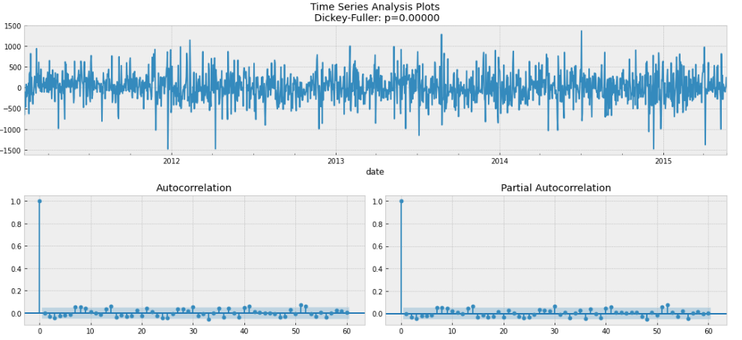
Store CA1 Full Year Model - Residuals
Residuals are stationary, and there are no apparent autocorrelations

Slide 16
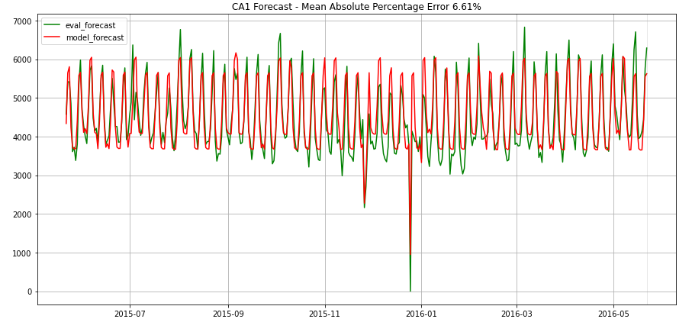
Store CA1 Full Year Model – Evaluation
Actual sales FY (2014-05-23 to 2015-05-22) | 1,600,222
Forecast sales FY (2014-05-23 to 2015-05-22) | 1,595,730
Difference | 0.28%
Target Growth for next FY (2015-05-23 to 2016-05-22) | 5%
ie Target sales | 1,680,233
Forecast sales for next FY (2015-05-23 to 2016-05-22) | 1,659,149
Gap | 1.25%
Actual sales for next FY (2015-05-23 to 2016-05-22) | 1,633,096
Actual sales for next FY vs Forecast sales | -26,053
Behind Target | -2.81%
With the target growth of 5% over prior year, budget looks achievable if business environment is as per prior year
Mean Absolute Percentage Error (MAPE) of forecast sales and actual sales for next FY turns out to be 6.61%. With hindsight, actual sales was lower than forecast sales, lower than Target!
Retail Store CA1 needs to monitor sales performance closely for next year

Slide 17
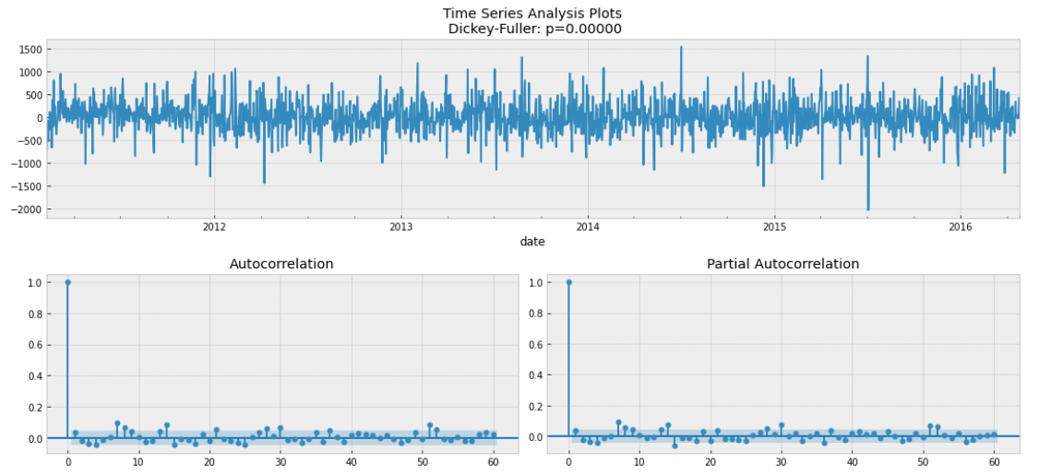
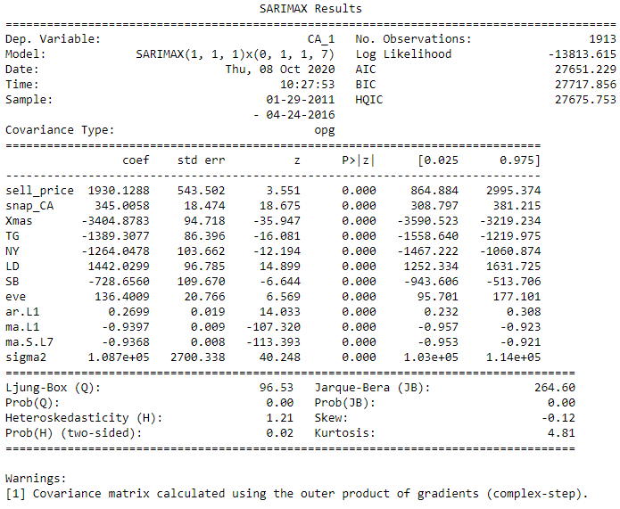
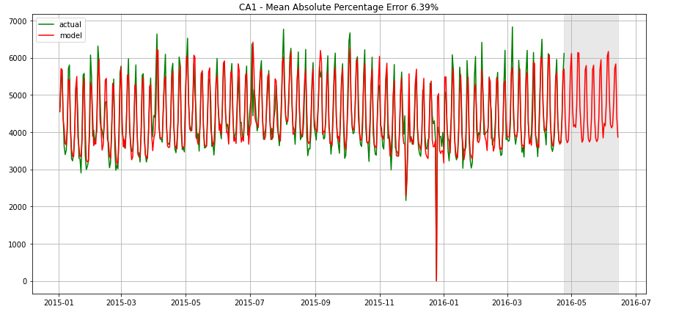
Store CA1 Forecast Model for Next 28 days
Using similar exogeneous variables as Full Year model and with latest data
Residuals

Slide 18
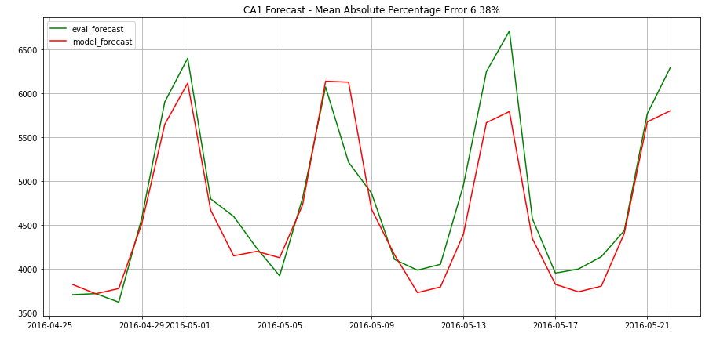
Store CA1 Forecast for Next 28 days - Evaluation
Monitor the daily sales performance against the forecast to identify any actions required
Retail store CA1 needs to monitor closely after 2016-05-15 whether there is sufficient stock for a possible uptick in sales
Mean Absolute Percentage Error (MAPE) of forecast sales and actual sales for next 28 days is 6.38%. With hindsight, actual sales was higher than forecast sales

Slide 19
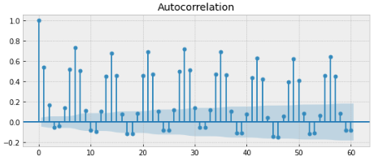
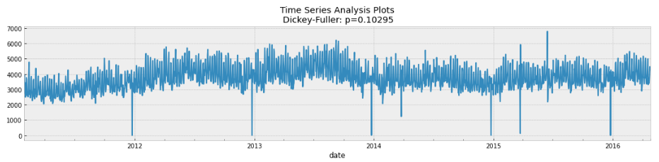
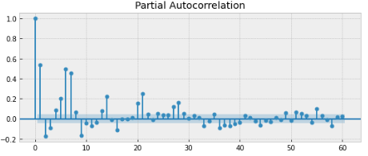
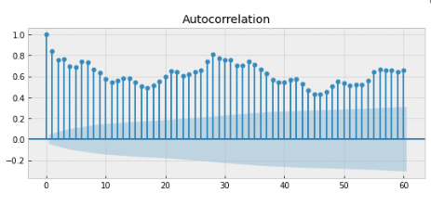
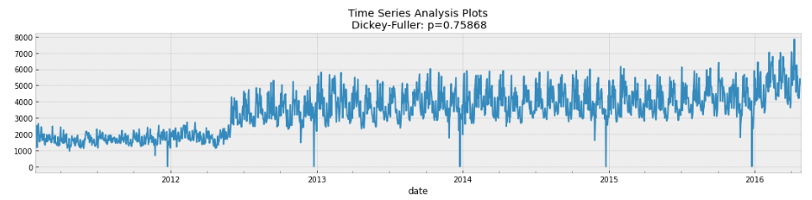
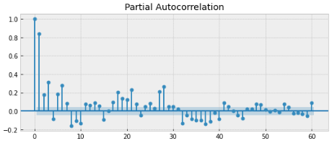
Is CA1 Model applicable for other stores ?
TX2
WI2

Slide 20
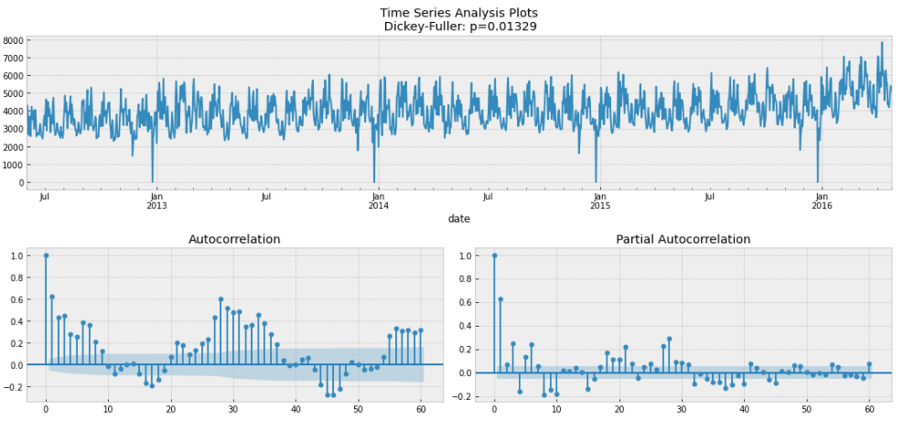
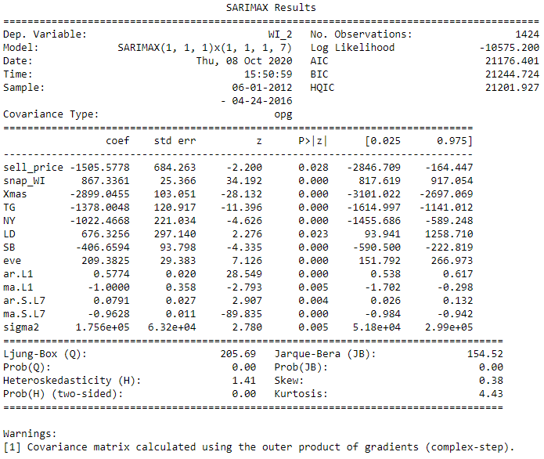
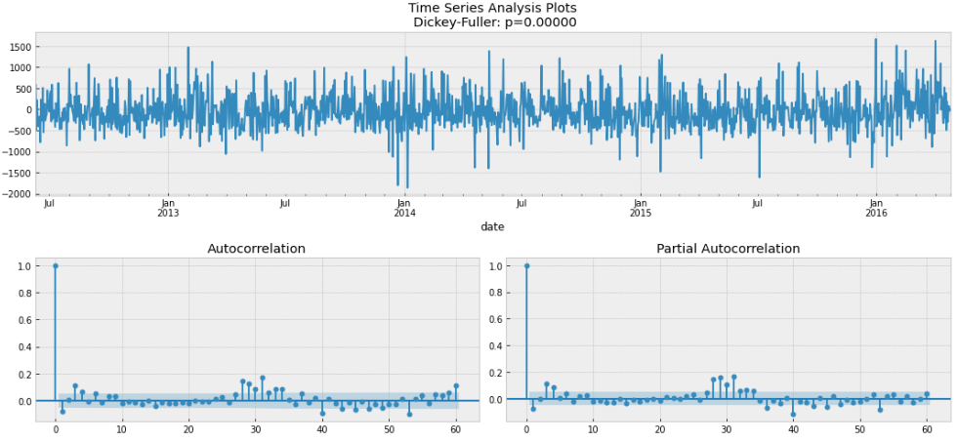
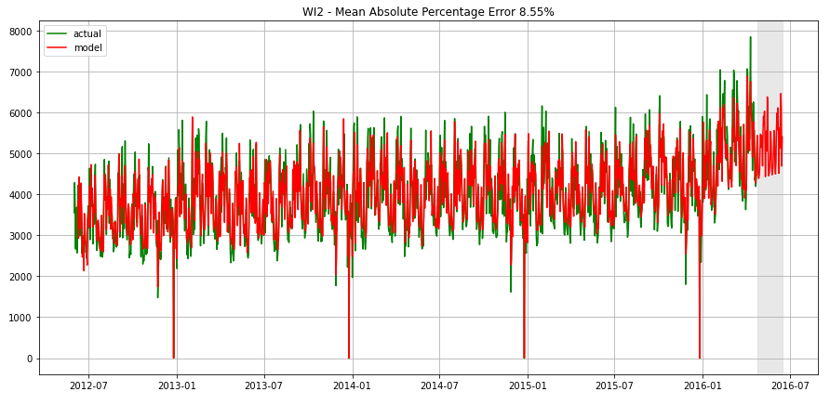
Store WI2 Model
Discarded 2011 – 2012-05 sales data as spike in sales volume on 2015-06 distorted model predictability
Residuals

Slide 21
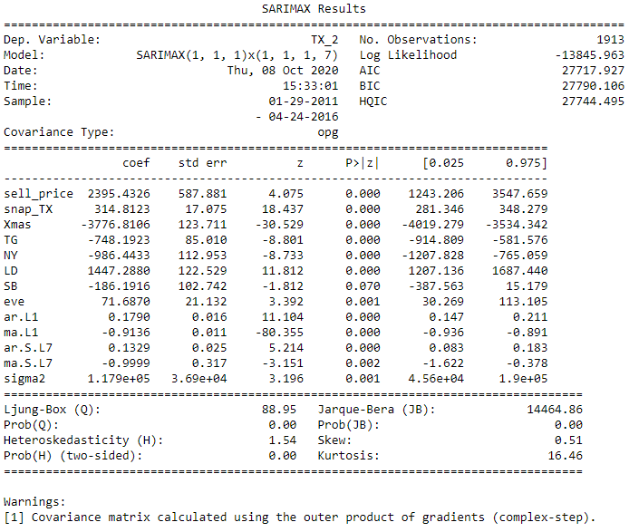
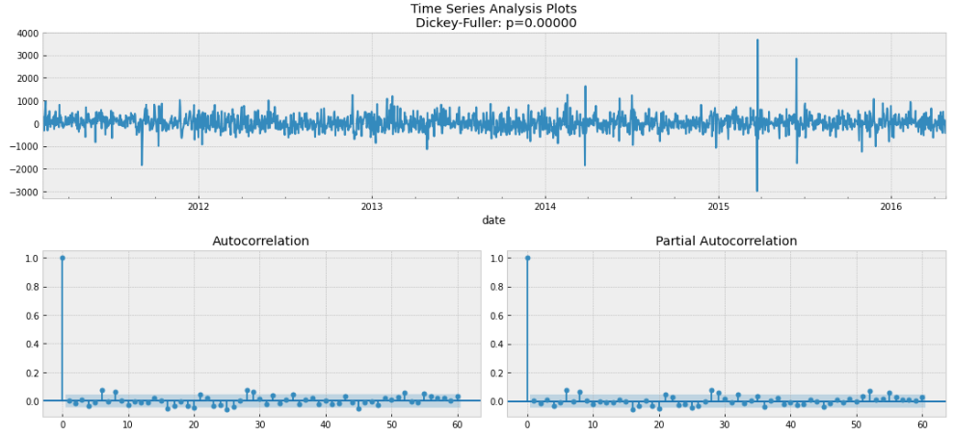
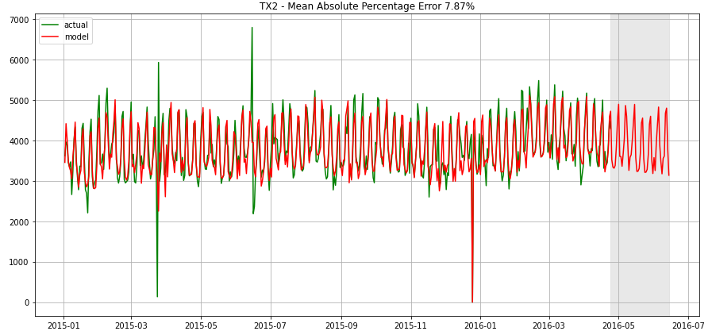
Store TX2
CA1 model is generally applicable for TX2
Residuals

Slide 22
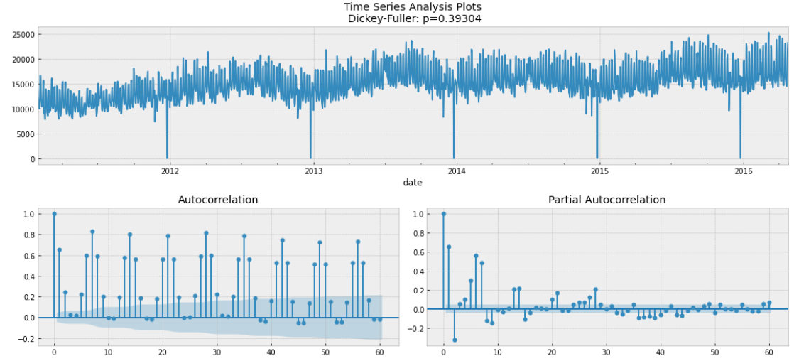
Is the Forecast Model scalable ? State CA Daily Timeseries

Slide 23
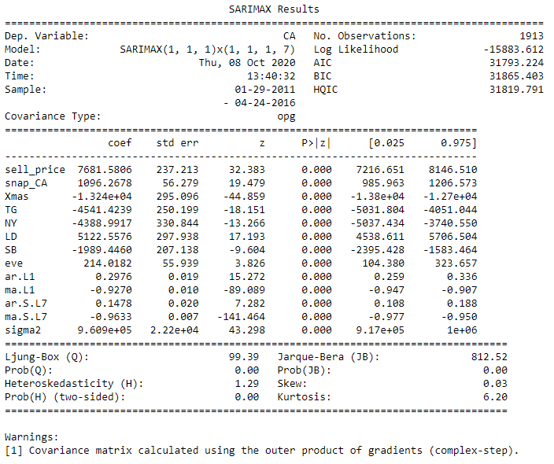
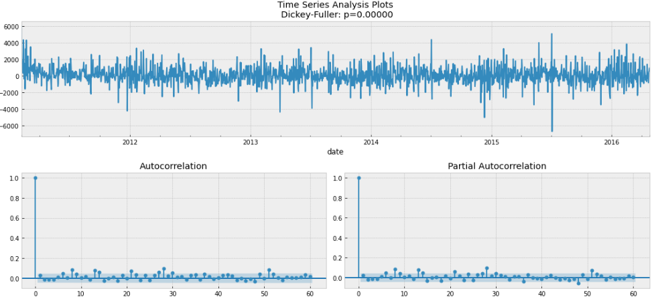
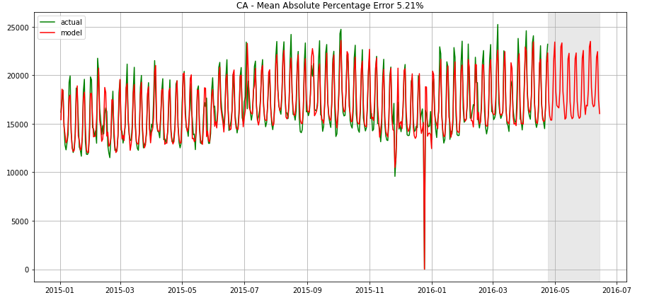
State CA Model for next 28 days
Similar Exogenous variables as Store CA1 model
Residuals

Slide 24
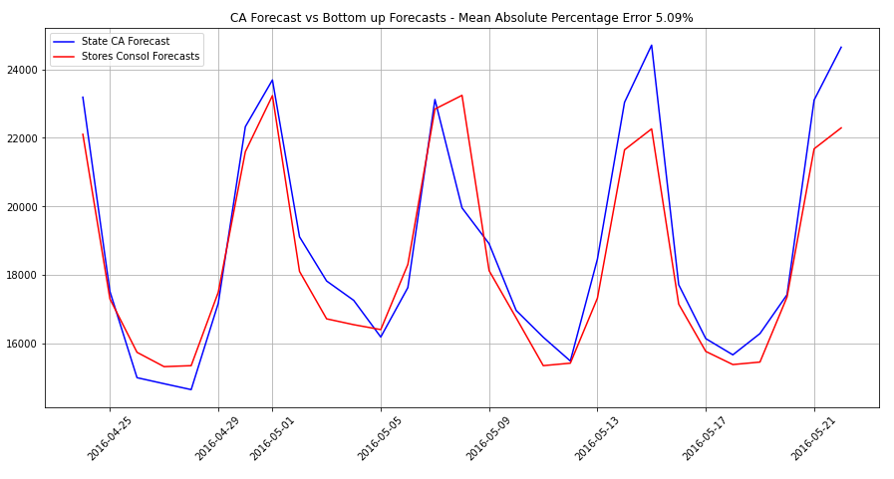
Reconciliation of State CA and Stores models
Store | Mean Absolute Percentage Error - Model | Mean Absolute Percentage Error - Evaluation | Actual Sales of next 28 days | Forecast Sales of next 28 days
CA1 | 6.39% | 6.38% | 134,032 | 129,859
CA2 | 7.18% | 7.16% | 132,920 | 126,717
CA3 | 5.96% | 5.95% | 175,360 | 178,987
CA4 | 6.04% | 6.06% | 78,858 | 74,784
Consol | - | - | 521,170 | 510,347
CA | 5.21% | 5.19% | 521,170 | 512,843
State CA model results in higher forecasts than consolidated stores’ models
Difference in the total sales predicted between the 2 models is not significant, 0.5%

Slide 25
Conclusions
Technical Values
Created full year and 28 days forecast models with prediction vs actual error rates less than 10%
Models are applicable to other stores and can be fine-tuned with specific events
Models are scalable
Able to manage huge data size vs MS Excel (maximum rows ~ 6m)
Business Values
Forecasts are built with explainable features
Allow performance tracking which can trigger prompt actions to be taken
Applicable for different industries

Slide 26
Appendix

Slide 27

Data Science Process
Ask a question
Explore Data
Model and validate
Communicate
Implement

Slide 28
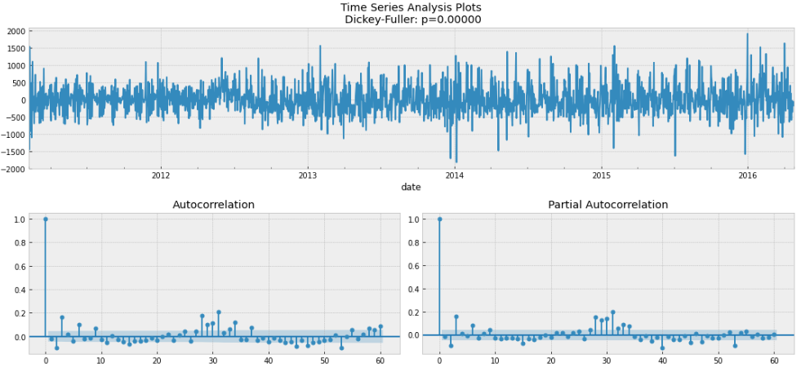
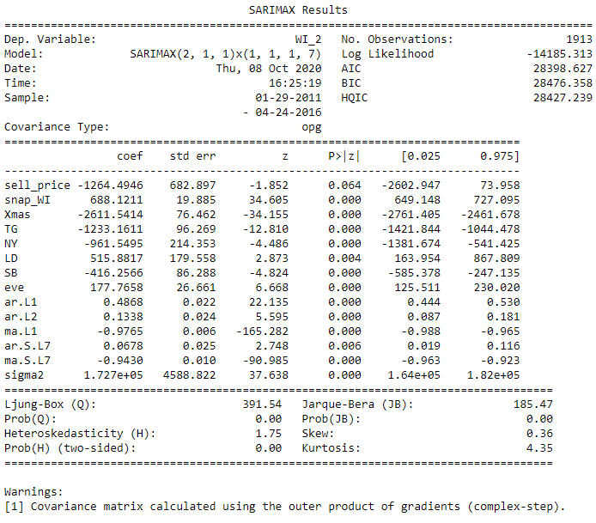
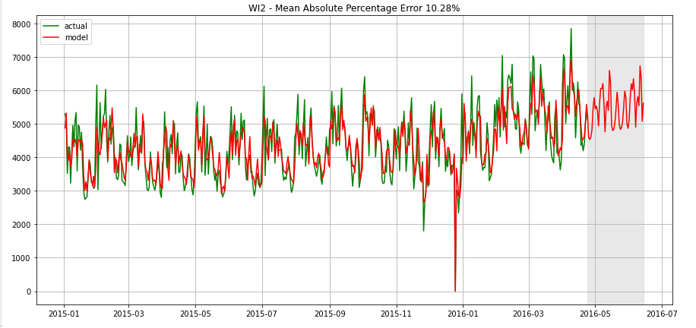
Store WI2 Models Comparison
WI2 forecast model using full set of data
Residuals

